Slide 1
‘THN’ Program Overview-2016
The goal of the THN program is to reduce harms related to opioid use including, overdose and death, by ensuring kits are accessible at various distribution sites throughout the province.

Slide 2
Community Based Naloxone (CBN) Project Mission-2018
To ensure anyone who is at risk of witnessing an opioid overdose obtains naloxone through an accessible compassionate and non-stigmatized interaction, and will understand how to correctly respond to an opioid overdose; including notification of emergency services, rescue breathing, and provision of naloxone.

Slide 3
CBN Program Overview
Objectives
To provide access to CBN kits and training for Albertans through a wide distribution network.
To facilitate collaboration among stakeholders.
To build capacity through resources and supports to registered sites.
To provide education and training to registered sites.
To increase public awareness of naloxone kit availability and use.

Slide 4
CBN Program Overview
Administration
Alberta Health
Procurement
Education and training
Partners
ACCH
Pharmacies
Operations
HRSC
Distribution
Non-pharmacy sites
Policy
Communications
Legal
Surveillance
Evaluation
HPSP
Professional Colleges
MFR
FNIHB

Slide 5
CBN Program Overview
Overdose Response Kit Distribution
As of March 31, 2018
Cumulative Totals: 54,157
Number of Reported Reversals: 3,607
Number of Providers/Sites:1501

Slide 6
Distribution Sites
O'Chiese Health Centre
Bighorn Health Centre
Dr. Thomas Murray Tsuut’ina Health Centre
Fort McMurray PH for Gregoire Lake Reserve
Levern Clinic/Blood Tribe
Maskwacis Health Services
Nunee Health Society
Enoch Cree Nation Health Services
Fox Lake Nursing Station
Garden River Nursing Station
Aboriginal Friendship Centre of Calgary
Maskwacis Ambulance Authority Mobile Mental Health Team (Not for Administration)
Beaver Lake Health Services
Stan Daniels Healing Centre
Siksika Emergency Medical Services
John D'or Nursing Stations
Woodland Cree Cadotte Lake and Lubicon Lake
Stoney Trail Wellness Centre Eden Valley
Alexander First Nations Health Services
Tawow Community Centre
Calling Lake Community Health Services
Heart Lake First Nation Health Centre
Cold Lake First Nations Health Center
Poundmaker's Lodge Treatment Centres
Alexis Nakota Sioux First Nation Health Center
Sturgeon Lake First Nation
Harm Reduction Community Health - Blood Tribe Department of Health
Paul First Nation Health Centre
Kapown Rehabilitation Centre
Horse Lake Wellness Centre
Stoney Health Services
Morning Sky Health and Wellness
Duncan Health Centre
Sunchild Health Centre

Slide 7
Activities to Date
Procurement and distribution of kits throughout Alberta
Education and training
Intersectoral collaboration
Capacity building
Surveillance system development
Policy development
Evaluation
Public awareness

Slide 8
Legislative Changes
2016:
Reschedule naloxone to a Schedule 2 drug
2017:
De-Schedule naloxone
Ministerial Order to authorize Police, Peace Officers, Fire Fighters to administer injectable naloxone as part of their employment

Slide 9
Achievements
Largest distribution CBN network in Canada
Collaboration and partnerships
Development of education materials and resources
Surveillance
Program support through Naloxone.kit@ahs.ca
Public awareness and support through Drugsafe.ca

Slide 10
CBN Project Description-Baseline

Slide 11
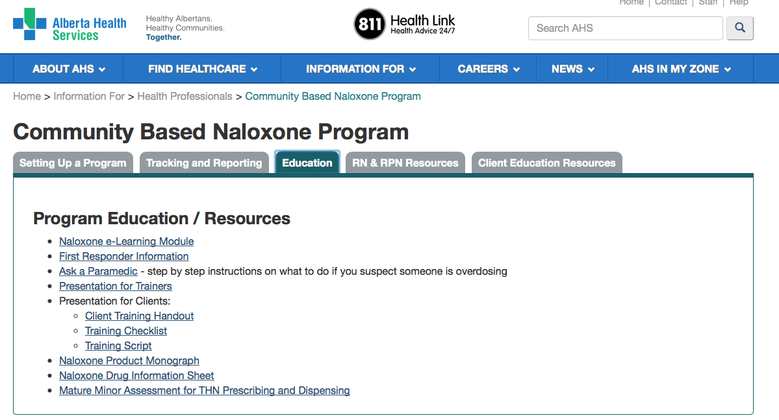
CBN Project Description-Baseline

Slide 12
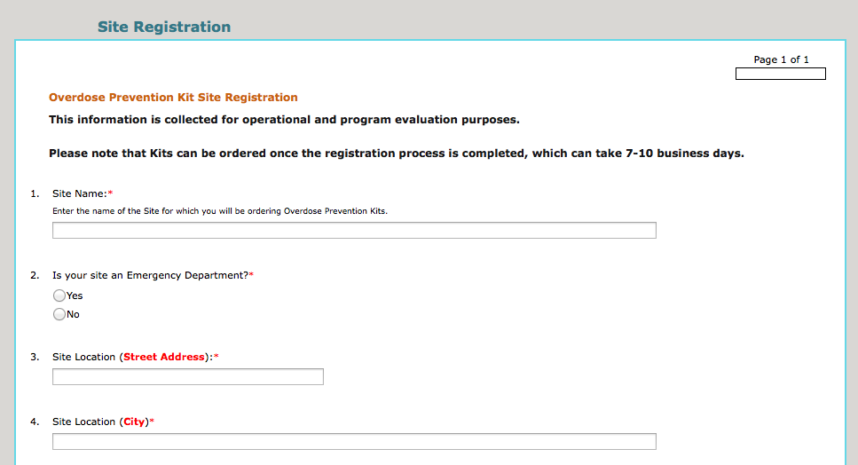
CBN Project Description-Baseline

Slide 13
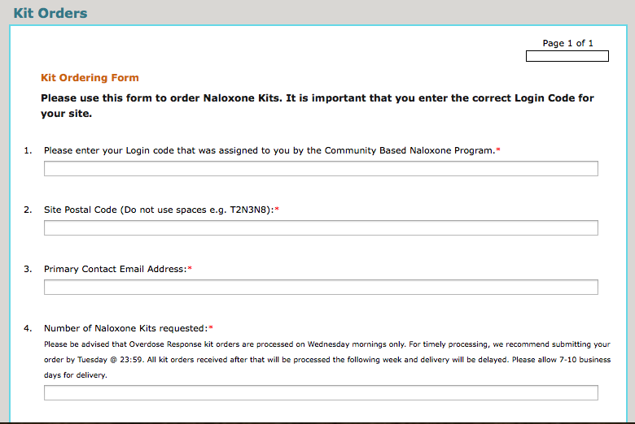
CBN Project Description-Baseline

Slide 14
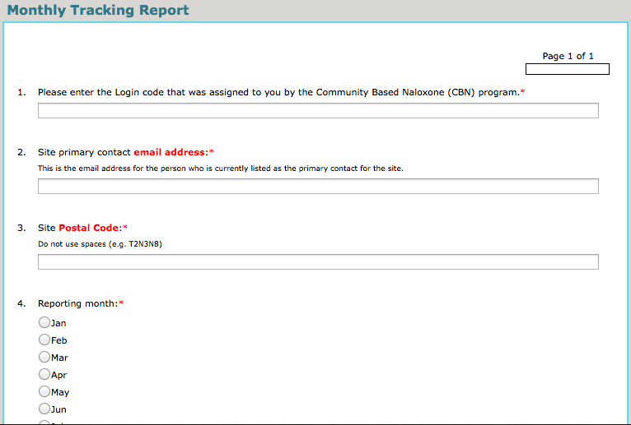
CBN Project Description-Baseline

Slide 15
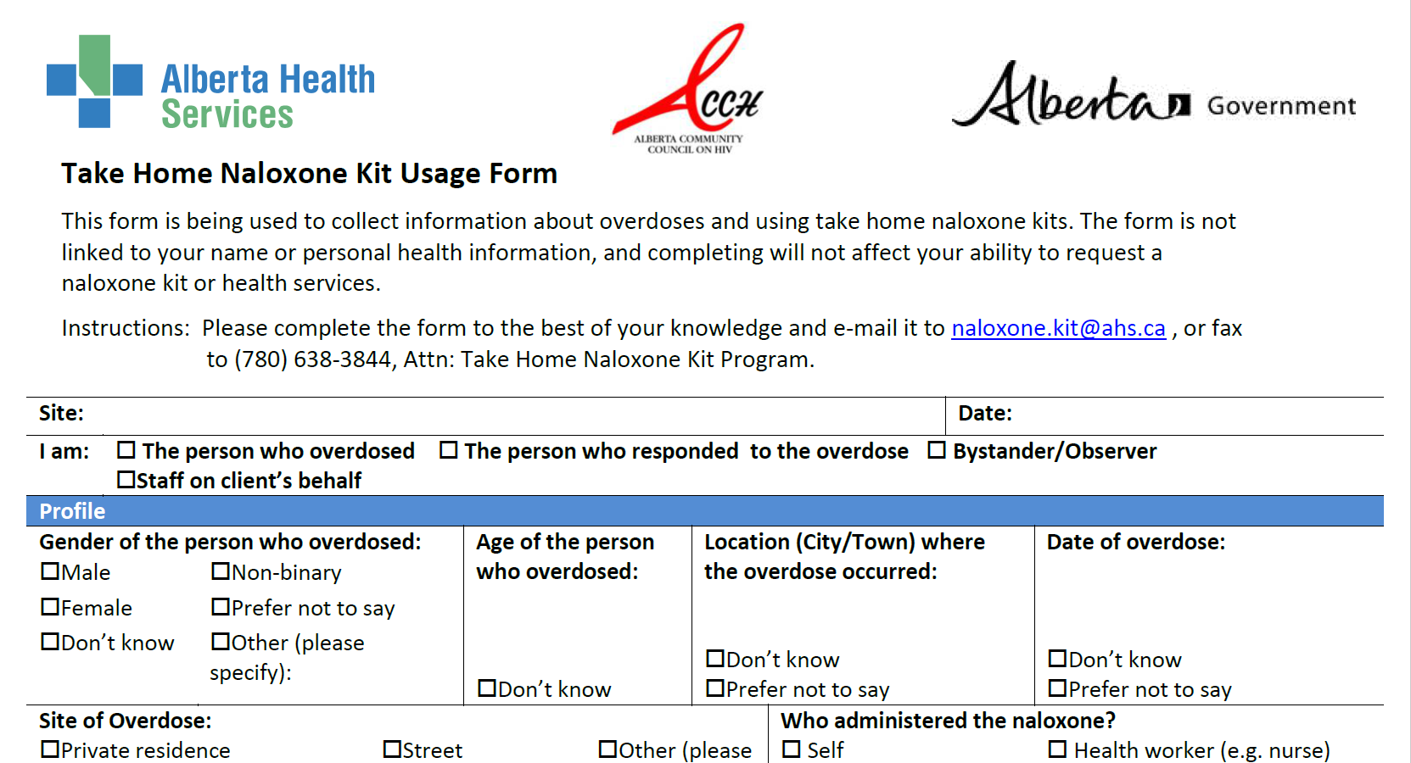
CBN Project Description-Baseline

Slide 16
Challenges
Increased demand for kits
CBN access in rural, remote, and First Nation communities
Legislative changes
Quality assurance
Data collection and reporting
Supply chain issues

Slide 17
CBN Program
Recent changes:
Increased number of vials from 2 to 3
Merger with ACCH CBN program
Addition of Medical First Responder agencies
Need for training materials and resources for non-health care providers
Replacement of expired kits
Distribution of kits at ED/UCC/acute care

Slide 18
Future Directions
Expand education and training materials
Enhance partnership with ACCH
Quality Assurance projects
Harm Reduction Services Team

Slide 19
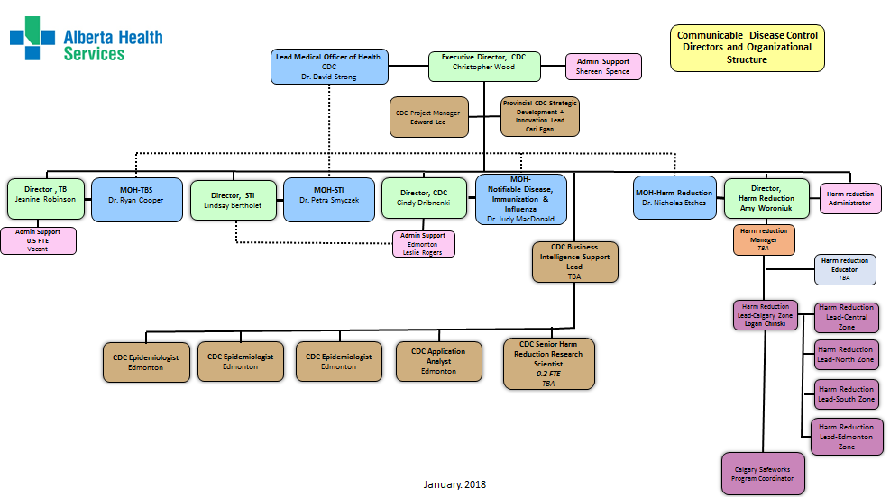
Harm Reduction Services Team

Slide 20
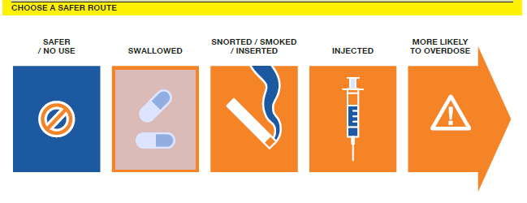
OVERDOSE PREVENTION
How can we support clients who are actively using opioids?
Provide education about overdose prevention!
Key messages:
Do not use alone
Use safer routes
Do not mix drugs
Do a small test dose first
Know the signs and symptoms of an overdose
Carry an Overdose Response Kit & call 911 for help
Know where to find resources

Slide 21
RECOGNIZING AN OVERDOSE

Slide 22
WHAT NOT TO DO
If someone is overdosing from an opioid, do not…
Let them sleep it off
Give them uppers to wake them up
Put them in a cold bath or shower
Slap, hit or punch them to try to wake them up
Try to get them to vomit

Slide 23
WHAT TO DO
Carry an Overdose Response Kit!
Know someone at risk of a drug overdose? Are you likely to witness a drug overdose (e.g., someone you know, or known drug use in your area)?
Free Overdose Response Kits and training are available
Find a site near you at Drugsafe.ca

Slide 24
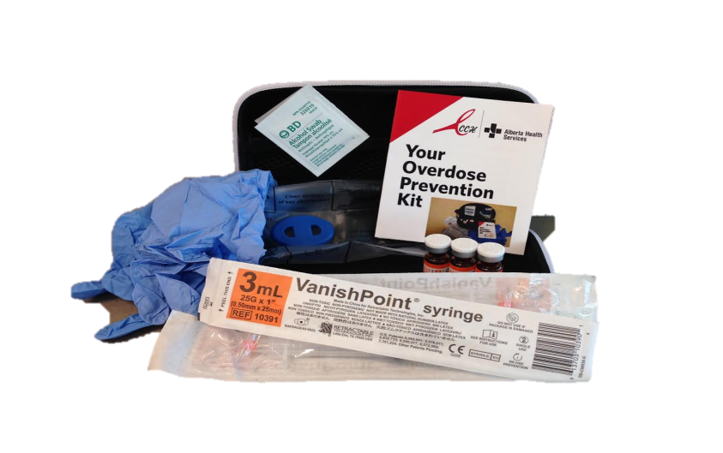
OVERDOSE RESPONSE KIT
Each kit contains:
3 vials naloxone (0.4mg/mL)
3 safety syringes with needles
3 alcohol swabs
1 pair gloves
One-way rescue breathing barrier mask
Kit information pamphlet
Always open the kit and check that all components are correct before handing it out.

Slide 25
OVERDOSE RESPONSE: SAVE ME
Always perform a safety check of your surroundings for sharps, blood, or traces of drug that could pose a risk to you before responding to an overdose
STIMULATE – Sternal rub. If unresponsive, call 911 for EMS.
AIRWAY – Are they breathing? Ensure airway is open and begin rescue breathing or CPR if directed by 911 dispatcher.
VENTILATION – Give 1 breath every 5 seconds for 2 minutes. Chest should rise with each breath.
EVALUATE the situation for changes. If no change, inject naloxone.
MUSCULAR INJECTION – Inject 1 dose naloxone to middle outer thigh. Onset of effects is 2-5 minutes. Continue to ventilate.
EVALUATE again – Administer another dose of naloxone as needed and continue with ventilation until EMS arrives.

Slide 26
STIMULATE
Can you wake the person?
Do they respond to stimulus?
If not – CALL 911
Answer the dispatcher’s questions briefly and clearly
Tell the dispatcher that you need EMS for a person who is unresponsive/unconscious and not breathing
Describe the situation and follow the dispatcher’s directions
When EMS arrives, tell them what you know
What they took, how much and when
How long you have been giving rescue breaths or CPR
If you gave naloxone, how many doses and when

Slide 27
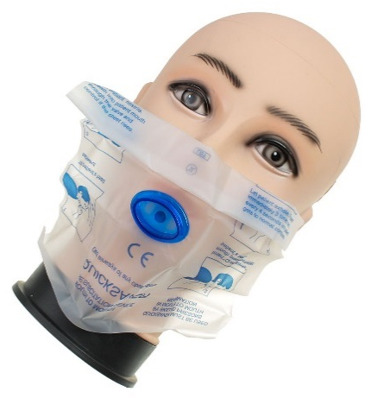
AIRWAY
If they are unresponsive and not breathing, start rescue breathing or initiate CPR as directed by 911 dispatcher
Place them on their back and tilt their head back and their chin up to open the airway and check to see if there is anything in their mouth blocking their airway
Use your barrier mask from the kit to cover their mouth
Plug their nose with one hand, and give 2 regular breaths through the mouthpiece. Their chest should rise.
If you don’t see their chest rise, tilt the head back more and make sure that you’re plugging their nose and covering the mouth to create a seal with the mask

Slide 28
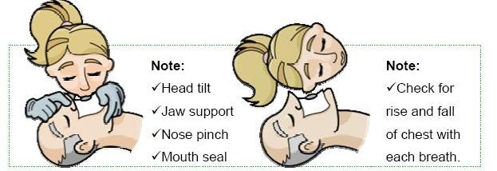
VENTILATION
Give one rescue breath every 5 seconds for 2 minutes

Slide 29
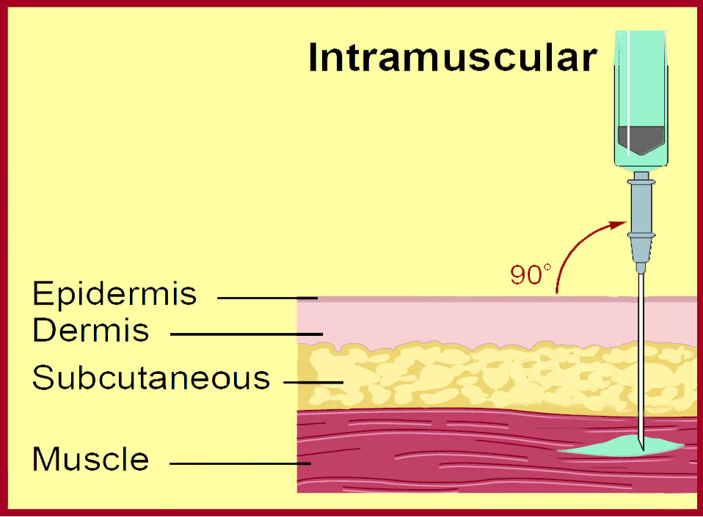
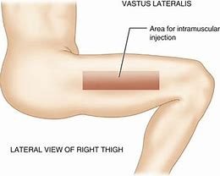
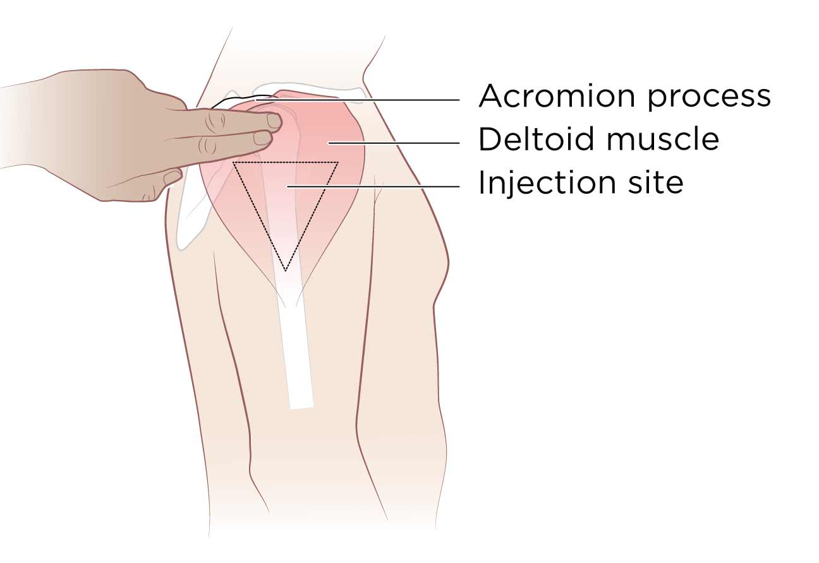
IM INJECTION
The middle outer thigh muscle is the preferred site for intramuscular (IM) injections because it is large and contains few major blood vessels or nerves that could be damaged by injection
The shoulder muscle (deltoid) site should only be used if the thigh muscle is unavailable

Slide 30
EVALUATE AGAIN
After giving the first dose of naloxone, unless the person is awake and breathing normally on their own, continue rescue breathing or CPR as instructed by the 911 dispatcher for another 2 minutes
Recall, naloxone has an onset of 2-5 minutes; if after this time there is no change or response, give 2nd and 3rd doses of naloxone as required
Stay with the person and continue rescue breathing or CPR as instructed by the 911 dispatcher until they are breathing on their own or until help arrives

Slide 31
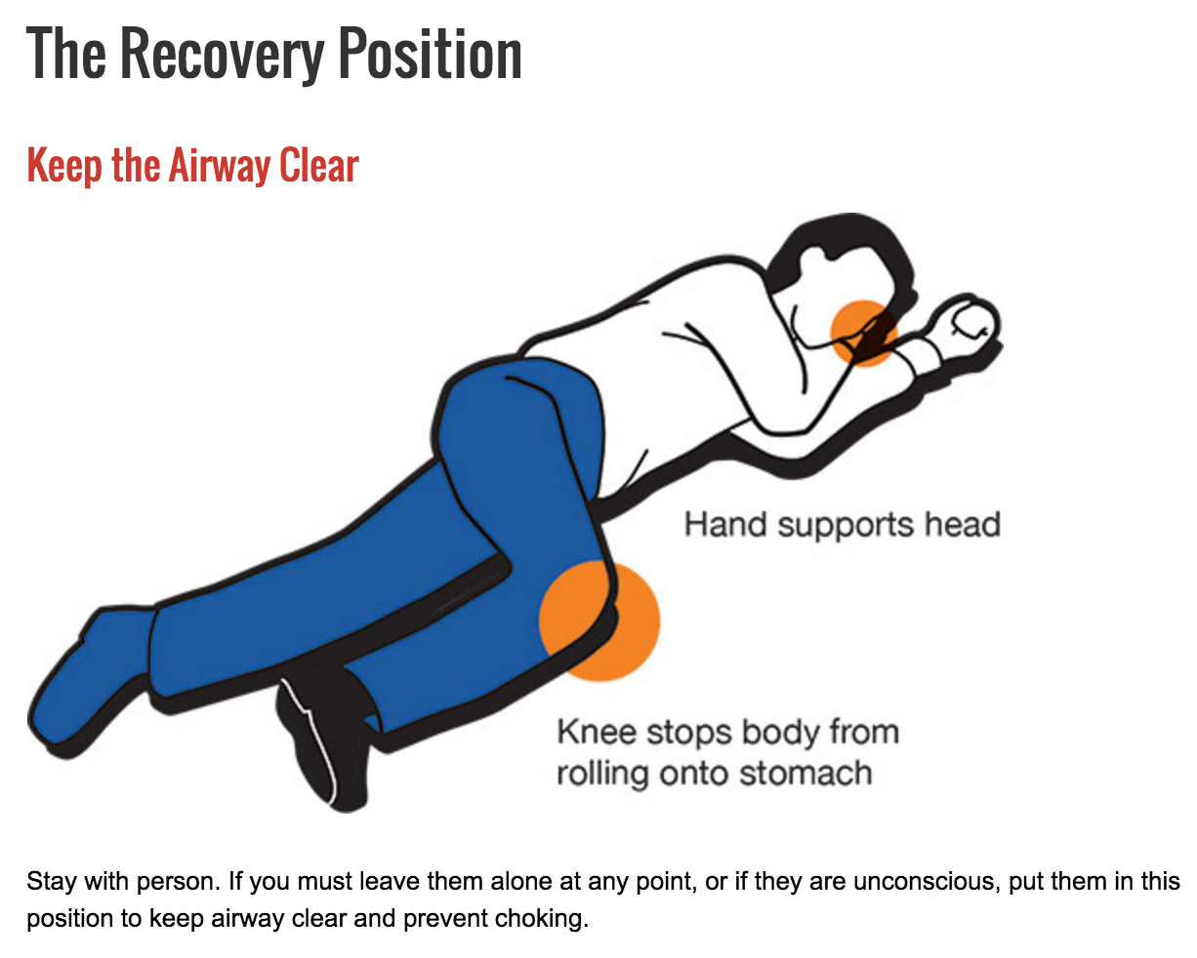
RECOVERY POSITION
If the person starts breathing on their own OR will be left alone, PUT THEM IN RECOVERY POSITION. This will help keep their airway open and prevent them from vomiting and choking
WAIT FOR FIRST RESPONDERS TO ARRIVE

Slide 32
AFTER THE EVENT
Information provided to Health Link or the ODR Kit Use Questionnaire is instrumental in understanding the impact of the CBN Program.
There are several ways to report that a kit has been used to respond to an overdose:
Visit the CBN webpage
Complete the Client Usage Reporting Form online
Email the completed Client Usage Reporting Form pdf to naloxone.kit@ahs.ca
Call Health Link at 811
Visit Drugsafe.ca or call Health Link at 811 to find out where and how to get a replacement kit.
For support and resources including debriefing with people you trust, please call:
Health Link at 811
Addiction Helpline at 1-866-332-2322 (available 24 hours a day, 7 days a week)

Slide 33
DISTRIBUTION OF ODR KITS
Community Settings and Emergency Departments/Urgent Care Clinics
Kits may now be handed out by individuals representing or working in conjunction with AHS (including non-health care providers) if they have successfully completed the required training.
Health care providers should always consult with their regulatory Colleges regarding scope of practice and responsibilities related to naloxone.

Slide 34
DISTRIBUTION OF ODR KITS
Community Settings and Emergency Departments/Urgent Care Clinics
Use the Client Handout and the Knowledge Checklist to review the key concepts related to opioid overdose prevention, recognition and response
Note that the recipient has the right to decline training; do your best to emphasize key points
Review the contents of the kit with the client and ensure the kit is complete
Complete the Distribution Record
The Monthly Reporting Tool must be completed monthly by one member of the team

Slide 35
Administration of Naloxone in Workplace Settings
Overdose Response Kits are not intended for use by the organization for workplace health and safety strategies or by staff for the treatment of patients experiencing an overdose related to clinical interventions at the site (e.g., procedural sedation).
The clinical settings should keep a stock of naloxone on site for this purpose.
Naloxone may be ordered through the site’s usual source for stock medications.

Slide 36
Contact Information
Please forward all Community Based Naloxone Program questions and concerns to:
Naloxone.Kit@ahs.ca

